Slide 1
IDS Project
Data exploration on FIFA rankings
Ishaan Lagwankar - PES1201700150
Arpit Agarwal - PES1201701084
Vishal Kanteppa Mahesh - PES1201700117

Slide 2
Overview
This project aims to do a structured analysis on the rankings of different countries on the basis of their placement on the FIFA football rank scale. The dataset includes different attributes of said countries based on their performance in the years 2014-2018.

Slide 3
Data Set and Introduction
Rank of the country
Country Abbreviation
Total points
Previous year points
Rank change
Current year average points
Current year average weighted points
Last year average points
Last year average weighted points
2 years ago average points
2 years ago average weighted points
3 years ago average points
3 years ago average weighted points
Confederation
Date ranking was taken
The data set gives a statistic overview of each international teams performance from 2014- 2018

Slide 4
Data Processing and Cleaning
Interpolation of Values
In interpolation, the missing value of a specific row is ”inferred” from the values of the previous and next years. This method is iterated throughout the data set rows replacing if and any missing values that the algorithm encounters in the data set
Categorical Cleaning
In categorical cleaning, some values of the dataset exhibit null behavior or give NaN values which are extracted by cleaning to be the values of the row above or below (in our cases above), making the data freely available to make further computations on.
Replacing with Central Tendencies
Sometimes, the numerical data is missing in large quantities, but the data around it may or may not be near the central tendencies of their respective columns. A valid cleaning could be done where we replace these missing values with the mean or median, which gives a good approximation of what that data might look like if the data given is to some extent close to its neighbouring values

Slide 5
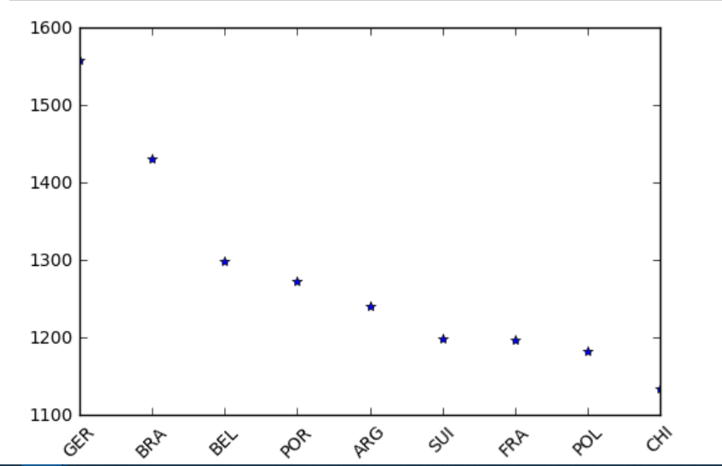
Analysis and Inferences
Total Points versus Teams

Slide 6
Difference in Total Points of the Top Two Teams
As the graph shows, the inferences drawn could be the magnitude by which Germany leads the rest of the teams, with Brazil, at second, far behind.
The Mid Tier Trends
The teams from the 3rd to 10th position have almost the same total points and are not entirely distinguishable in their performance from their members.

Slide 7
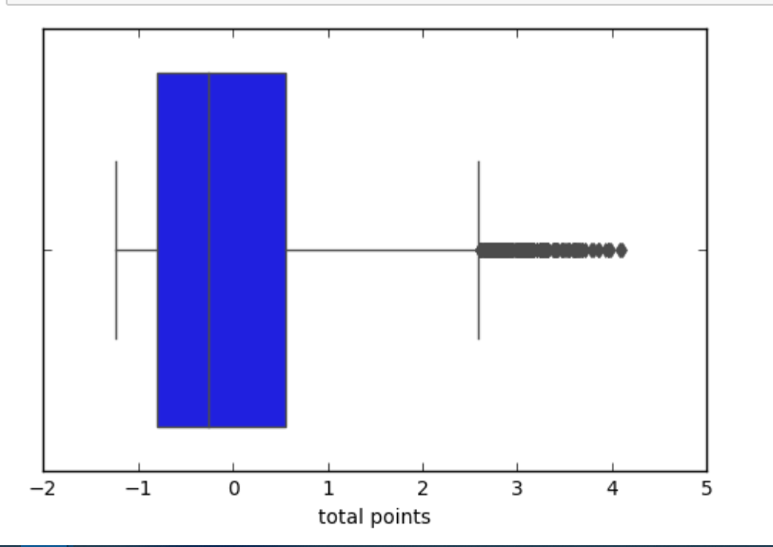
Rank Distributions - Total Average Points versus Number of Teams
Heavy Outliers
The boxplots of average points per year for five years versus the teams playing in that year is that the top tier teams are, in terms of net point gain, giving a much higher performance than that of the average performance per year.
Negative Mean
The middle and bottom tier teams are underperforming in comparison to the top tier teams, and have the mean point gain very low, skewing the mean value to a slight negative value.

Slide 8
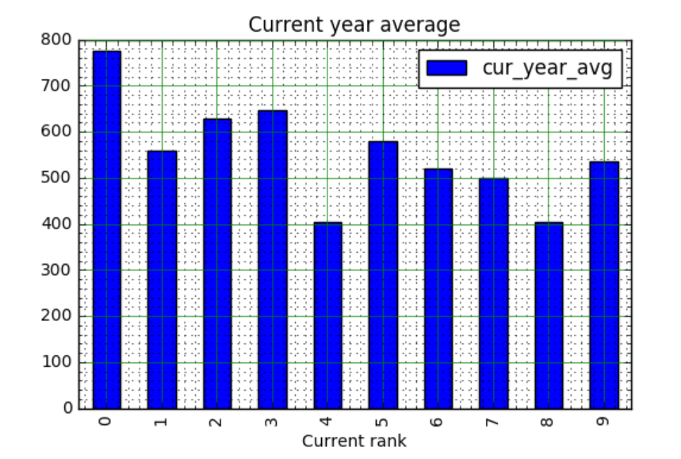
Rank - Average Statistics
Performance Statistics for the Top 10
The first ranked team’s performance proves to be significantly better than the neighbouring ranks. But, the graph shows how the second team’s performance is lesser than the subsequent team’s performance, indicating a rank change possibility in the next year.

Slide 9
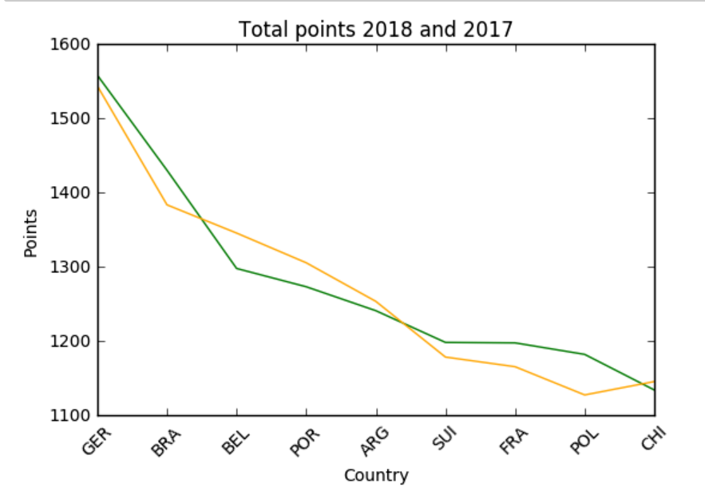
Performance Trends
Drawing vertical lines for each team gives a brief trend capture for a team over the two years. Here, the green line represents the points gained in 2018 and the orange line the points gained in 2017. The graph infers a increase in performance for Germany, Brazil, Switzerland, France and Poland. The rest have depreciated in performance.

Slide 10
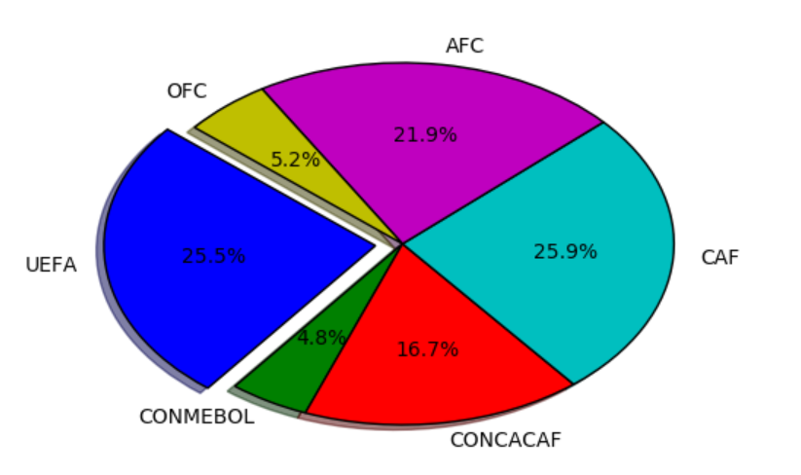
Confederation Breakup
The pie chart analyses the different confederations with the teams in the confederation. UEFA consists of the maximum number of teams and CONMEBOL with the least.

Slide 11
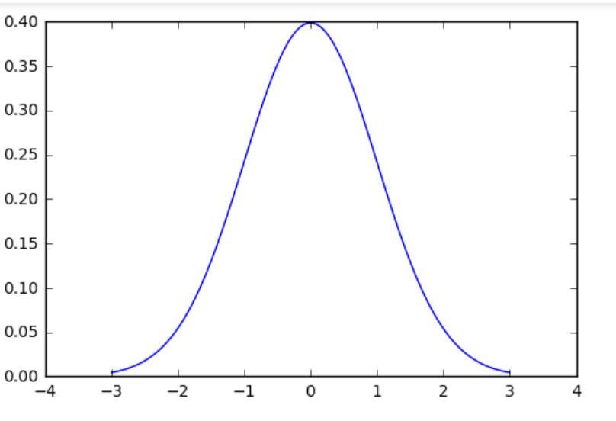
Normalisation
Total points
mu = totpts_norm.mean()
sigma = totpts_norm.std()
x = np.linspace(mu - 3*sigma, mu + 3*sigma, 100)
plt.plot(x, mlab.normpdf(x, mu, sigma))
plt.show()

Slide 12
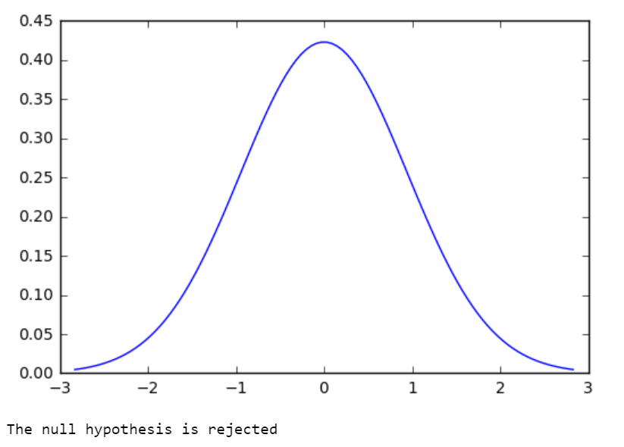
HYPOTHESIS TESTING
# Null hypothesis: the cur_year - last year >= 0
# Alternate hypothesis: the cur_year - Last year < 0
cur_year = []
last_year = []
diff = []
alpha = 0.05
…
cur_year1 = []
last_year1 = []
diff1 = []
for index, value in df['cur_year_avg'][10:19].items():
cur_year1.append(value)
for index, value in df['last_year_avg'][10:19].items():
last_year1.append(value)
for i in range(9):
diff1.append(cur_year1[i] - last_year1[i])
diff_mean1 = st.mean(diff1)
z = (diff_mean1 - mu) / sigma
prob_z = stat.norm.cdf(z)
if prob_z < alpha:
print("The null hypothesis is rejected")
else:
print("The null hypothesis is accepted")

Slide 13
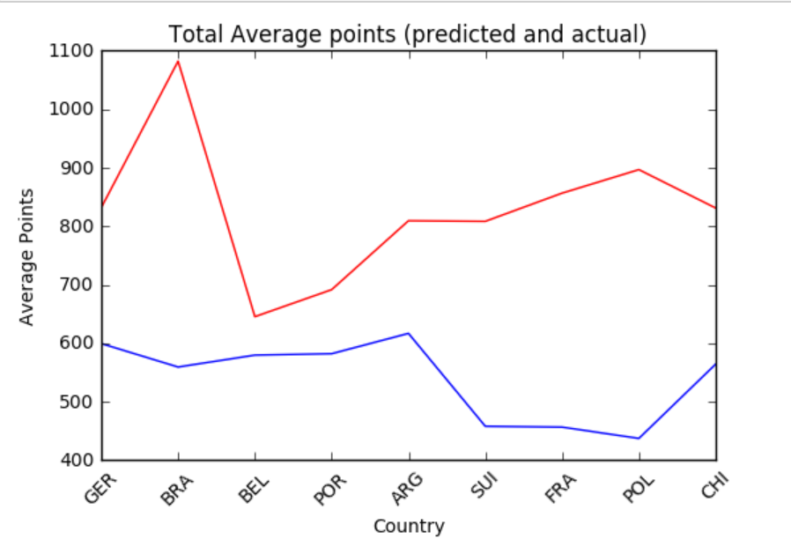
Predicting the Total Average Points - Experiment
In the experiment, a thought was carried to see if the total average points gained by a team could be inferred using the total points gained by the team previously, using a basic hypothesis test, trying to understand if the current values obtained share a relation with the previous values.

Slide 14
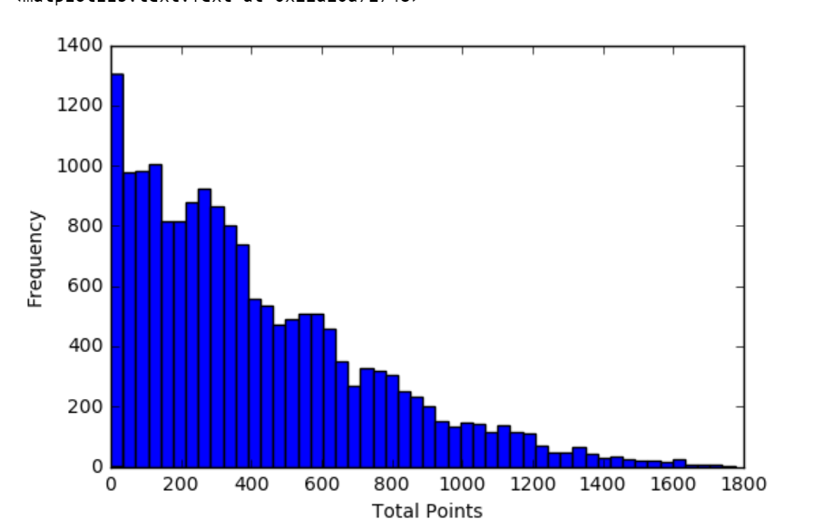
Frequency versus Total Points Average
The following graph shows that as the total number of points scored per team increases, the frequency of the total number of points scored decreases.

Slide 15
Conclusions
The top 10 teams are outliers in the sense that they are completely distinguishable from the rest of the teams by a heavy margin
The UEFA confederation hosts the highest number of teams, and the CONMEBOL confederation hosts the least.
It is impossible to predict the total average points for any year, as the trends are not following a pattern of definitive increase or decrease.
Increase and decrease in perform does not increase or decrease linearly, and is unpredictable.
Thank You!

